Slide 1



AtliQ Technologies
SHIELD INSURANCE
ANALYSIS
Presented by : Sachin Savkare
This presentation was developed during the Data Analytics Internship at AtliQ Technologies, facilitated by Codebasics.

Slide 2
SHIELD INSURANCE – EMPOWERING HEALTH
Health Insurance : ENSURING PEACE OF MIND
Shield Insurance specialize in comprehensive health insurance solutions that safeguard individuals, families, and Corporate Clients against the financial burdens of medical emergencies.
Shield Insurance Product Portfolio ranges from basic medical plans to high-value critical illness covers tailored to suit every health and financial profile.
Plan Tier | Coverage Range | Target Audience
Basic Health Plans | ₹2 – ₹5 Lakhs | Individuals, Young Professionals
Family Floater Plans | ₹5 – ₹10 Lakhs | Nuclear & Small Families
Top-up/Super Plans | ₹10 – ₹25 Lakhs | Health-conscious Families, Seniors
Critical Illness Plans | ₹25 Lakhs – ₹1 Crore | HNIs, Corporate Clients, High-Risk Patients

Slide 3
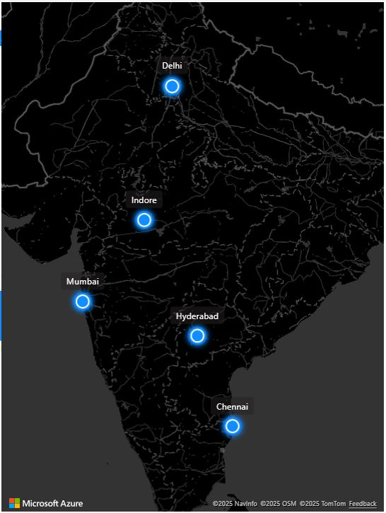
Health Insurance Policy and Market Position in India
Policy | Base Coverage (INR) | Base Premium (INR) | Likely Insurance Type
POL4321HEL | 2,00,000 | 5,000 | Health Insurance (Basic Plan)
POL4331HEL | 3,00,000 | 7,500 | Health Insurance (Mid Tier)
POL3309HEL | 5,00,000 | 12,000 | Health Insurance (Family Floater/Comprehensive)
POL5319HEL | 7,50,000 | 16,700 | Health Insurance (Extended Coverage)
POL6303HEL | 10,00,000 | 21,500 | Health Insurance (Higher Coverage)
POL6093HEL | 15,00,000 | 31,700 | Health Insurance (Premium/Top-up)
POL9221HEL | 25,00,000 | 42,500 | Health Insurance (Corporate/High Net Worth)
POL1048HEL | 50,00,000 | 76,500 | Health Insurance (Premium or Critical Illness Plan)
POL2005HEL | 1,00,00,000 | 1,20,000 | Health Insurance (High Coverage/Critical Illness/Cancer)
2022
NOV
DEC
Year
2023
JAN
FEB
MAR
APR

Slide 4
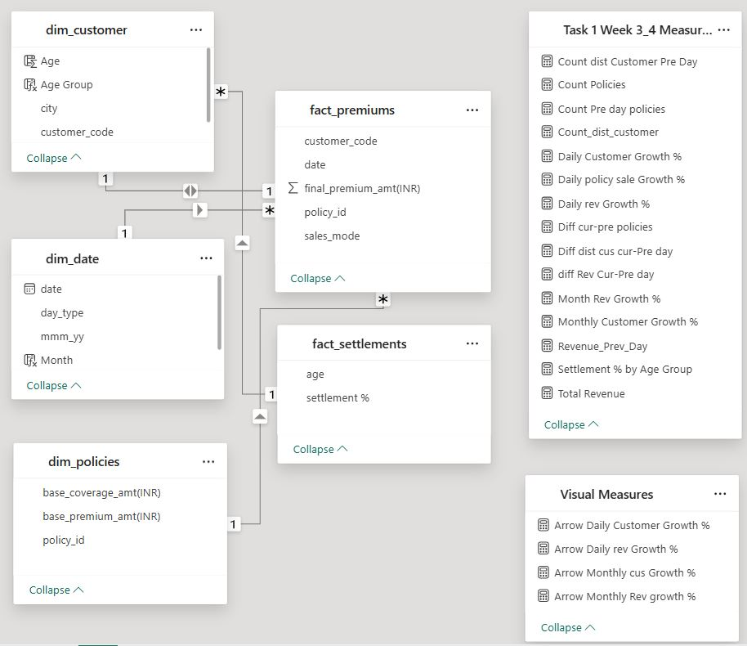
Data Modelling and Measures
Dimension and Fact Tables
Dimension Tables
dim_customer
dim_date
dim_policies
Fact Tables
fact_premiums
fact_settlements

Slide 5
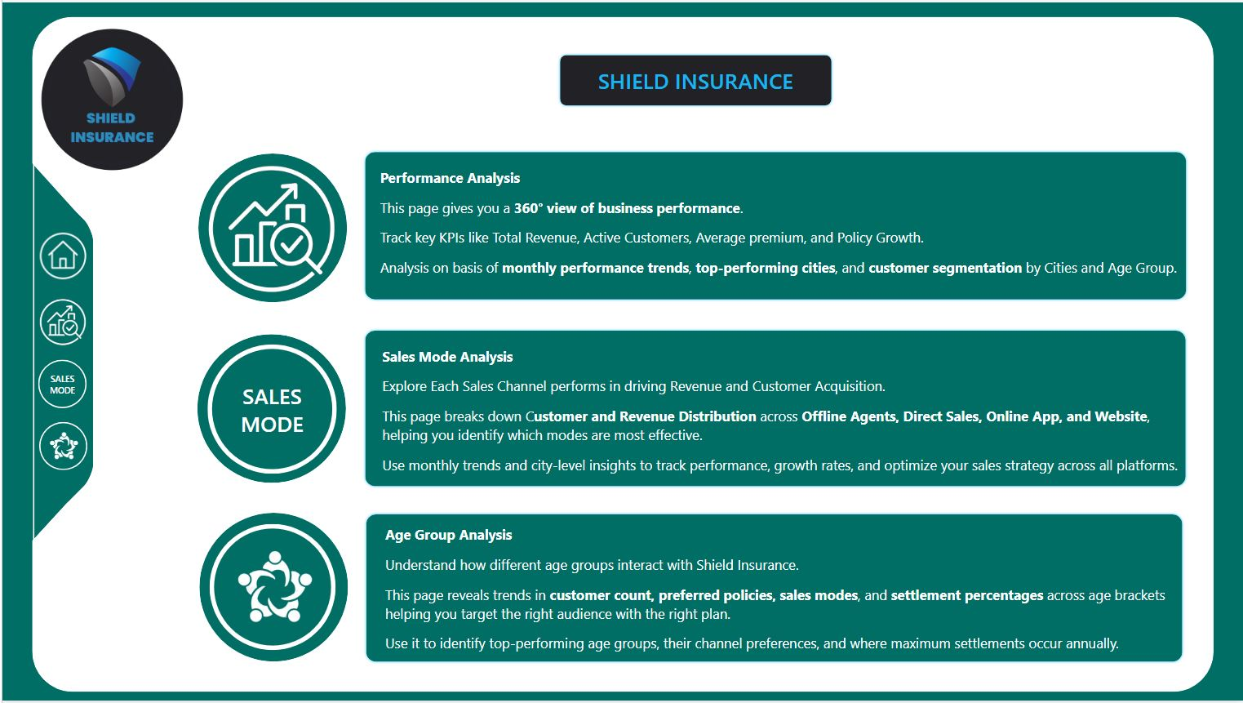
Dashboard View
Home Page
Performance Analysis
Sales Mode Analysis
Age Group Analysis

Slide 6
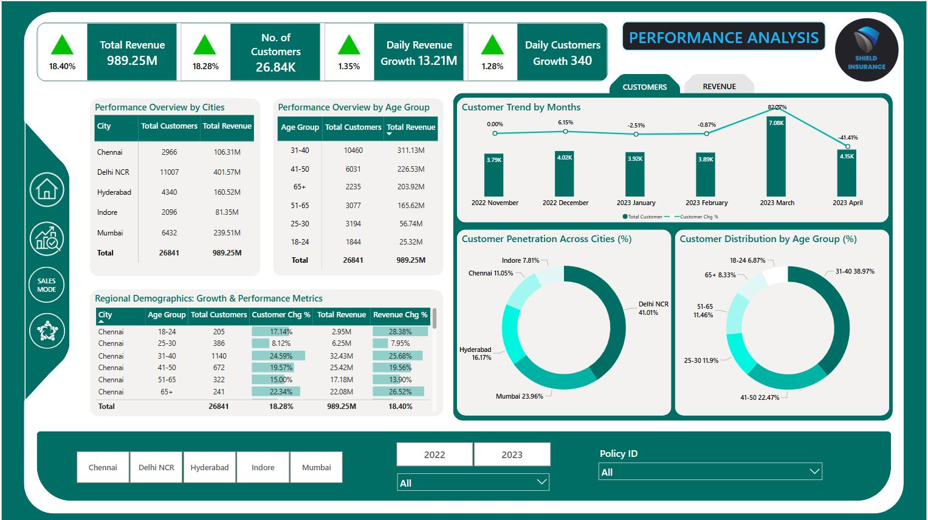
Dashboard View
1. Performance Analysis

Slide 7
Insights (Customer & Revenue Performance: Nov 2022 – Apr 2023)
Performance Analysis View
Customer Performance Trends:
Customer growth was steady from Nov 2022 to Jan 2023, with visible gains in penetration across metro cities and age groups (especially 18–30).
Dip in customer numbers observed in Jan 2023 & Feb 2023, likely due to either seasonal inactivity or policy maturity gaps.
Recovery in March, with April 2023 reaching the highest customer engagement, particularly among the 31–40 age group.
Consistent dominance of urban/metropolitan cities in customer base.
2. Revenue Performance Trends:
Revenue followed a similar curve to customer data increasing from Nov to Jan, noticeable drop in Feb, and peak recovery in March & April 2023.
Jan 2023 marked the lowest revenue month, despite not having the lowest customer base this suggests:
Customers may have opted for low-premium policies.
Higher share of younger/less premium-paying customers.
Revenue per customer was highest in March, indicating possibly higher-value policies sold or renewed

Slide 8
Insights (Customer & Revenue Performance: Nov 2022 – Apr 2023)
Performance Analysis View
3. City-Level Observations:
Top cities like Delhi NCR, Mumbai, Hyderabad consistently lead in both customer count and revenue.
Tier-2 cities showed stable growth but did not significantly impact top-line revenue.
City contribution ratio remained static – suggesting opportunity in localized campaigns for underperforming regions.
4. Age Group Trends:
Age group 31–50 contributed most to both revenue and customer volume.
18–24 group had lower revenue contribution, indicating lower policy premiums or less engagement.
Older age groups (65+) had stable but small contribution, possibly due to high-risk premium costs or policy ineligibility.

Slide 9
Recommendations for Stakeholders
Performance Analysis View
1. Jan & Feb 2023 Action Plan:
Investigate root cause of drop in Jan &Feb 2023 , was it marketing lapse, policy expiry cycle, or customer churn?
Run Retention and re-engagement campaigns at the start of Q1 (Jan–Feb) to reduce off-season impact.
2. Boost High-Value Engagement:
Focus on age group 31–50, which shows both high customer count and revenue potential.
Consider targeted upsell campaigns in March–April window where revenue per customer is high.
3. Geo-Specific Strategies:
For tier-2 cities (Chennai & Indore) , design incentive-based acquisition campaigns to raise customer base.
For metro cities, focus on premium policy packages and renewal cycles to sustain revenue peak.
4. Product Mix Optimization:
Align policy offerings based on Age Group and City type:
Younger groups: Smaller, High-turnover Products
30+ groups: Higher coverage, bundled products
Evaluate if Sales modes (Online vs Agent-based) influenced revenue variation.

Slide 10
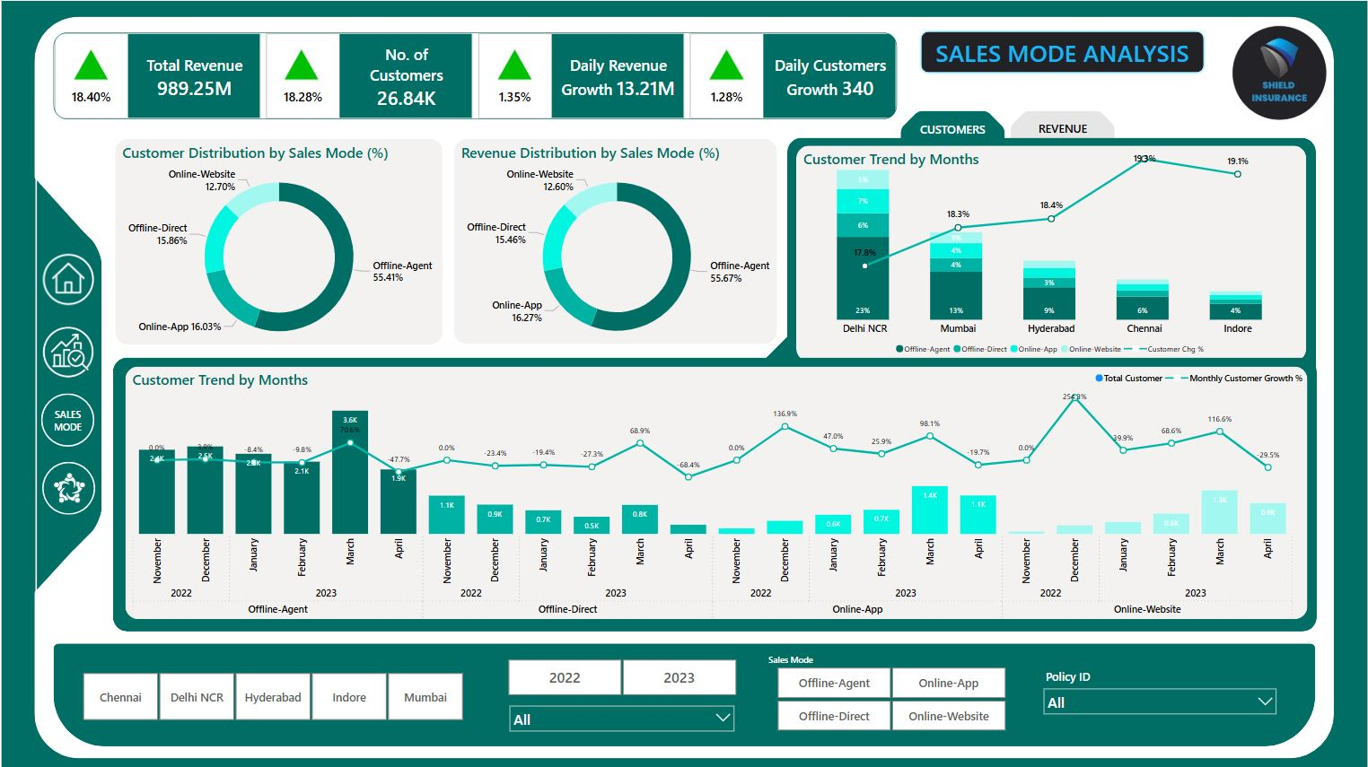
Dashboard View
2. Sales Mode Analysis

Slide 11
Insights
Sales Mode Analysis View
1. Sales Mode Performance:
Online Mode consistently leads in customer acquisition, averaging 40–45% share monthly.
Agent Mode contributes fewer customers but delivers higher revenue per customer.
Branch & Referral Modes have minimal and stagnant presence in both customer and revenue trends
2. Monthly Trends – Customer & Revenue:
Observation:
February remains a weak month across both metrics, likely due to low seasonal activity or policy cycle resets.
Month | Customer Trend | Revenue Trend | Dominant Sales Mode
Nov 2022 | Stable start | Moderate | Online & Agent
Dec 2022 | Slight increase | Moderate | Online growing
Jan 2023 | Continued growth | Revenue peak begins | Agent surge
Feb 2023 | Noticeable dip | Lowest revenue | Weakened across all
Mar 2023 | Strong recovery | Highest revenue | Agent dominates again
Apr 2023 | Customer peak | High, but slightly down | Online-driven

Slide 12
3. Sales Mode Contribution Summary:
Customer Distribution (%):
Agent: ~56%
Online: ~30%
Branch: ~15% + Referral: ~5%
Revenue Distribution (%):
Agent: ~56%
Online: ~30%
Branch + Referral: ~ 14%
Conclusion:
Agent Mode = High Value, Low Volume
Online Mode = High Volume, Lower Value

Slide 13
Recommendations
Sales Mode Analysis View
1. Double Down on Online – But Smarter
Drive scale via Online with intelligent upsell nudges (e.g., “Top-up your coverage”).
Introduce bundled digital policies or limited-time online-exclusive offers.
2. Empower Agent Channel
High-value revenue indicates potential to expand Agent network.
Use performance-based bonuses & CRM to target high-premium customers.
3. Energize Branch & Referral Channels
Consider hybrid on boarding at branches (walk-in + online handoff).
Launch referral campaigns for satisfied policyholders in metro cities.
4. Address February Dip
Pre-plan Q1 offers in January.
Launch retention drives or simplified renewal policies before February starts.

Slide 14
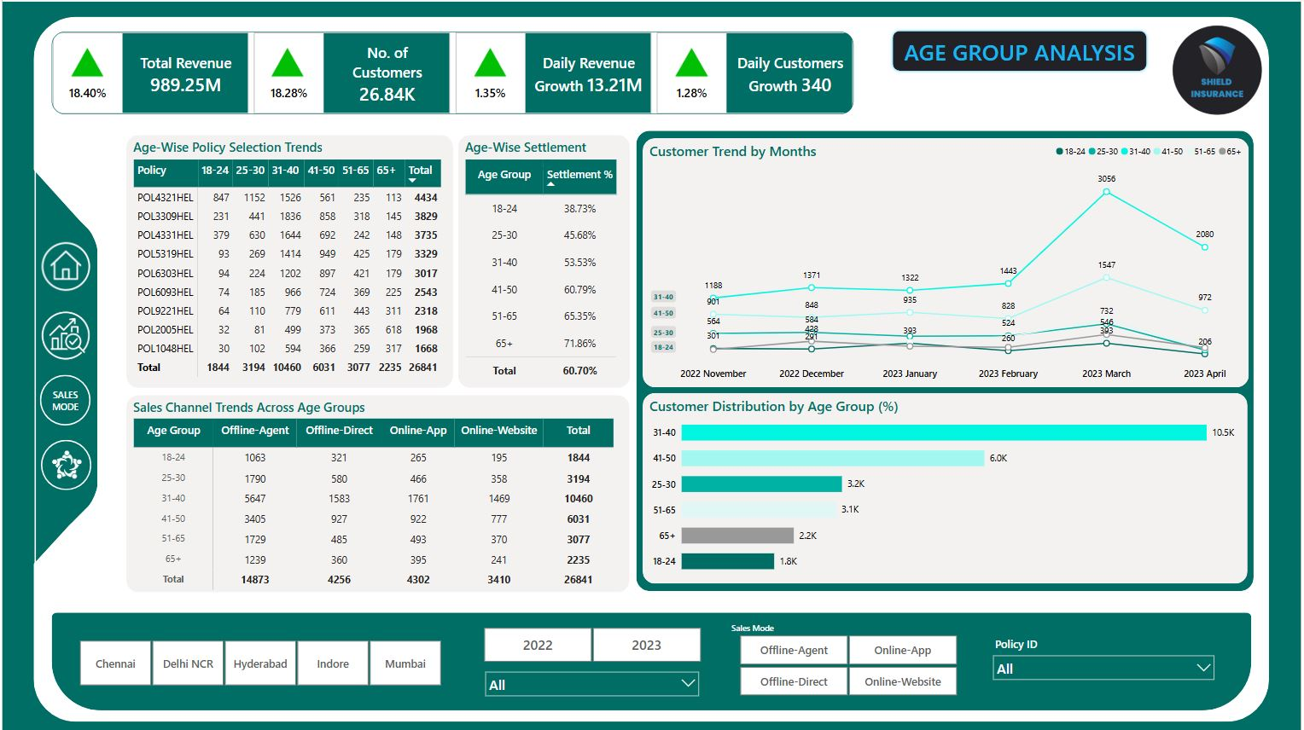
Dashboard View
3. Age Group Analysis

Slide 15
Insights – Age Group Analysis (Nov 2022 – Apr 2023)
1. 25–30 Age Group Leads Consistently
This segment consistently drives the highest customer volume and revenue across all six months.
Indicates strong product-market fit and effective targeting for this age band.
2. Emerging Growth from 31–40 Segment
After a modest start, this group shows steady growth in both revenue and customer count, especially in December and March.
Signals rising interest among mid-career individuals with purchasing power.
3. Volatility in 18–24 and 65+ Segments
The youngest (18–24) and oldest (65+) customer groups display inconsistent behaviour, with sharp dips in February and April.
These segments appear sensitive to pricing, seasonal factors, or messaging tone.
4. February 2023 – A Clear Low Point
All age groups exhibit reduced activity.
Could reflect seasonal disengagement or a lack of targeted campaigns during the mid-quarter.
5. March 2023 – Strongest Recovery Month
All segments, especially 25–30 and 31–40, bounce back with strong numbers.
Demonstrates potential when engagement strategies align with timing and targeting.

Slide 16
Recommendations: Age Group Analysis view
1. Double Down on the 25–30 Segment
Continue tailored campaigns, exclusive offers, and loyalty benefits for this high-performing group.
Consider introducing referral schemes or bundled offerings for peer groups.
2. Nurture the 31–40 Age Group into Power Users
Build value-driven plans (e.g., family or career-based insurance products) to lock in this rising group.
Use targeted storytelling and trust-based marketing.
3. Reignite the 18–24 Audience
Leverage digital-first strategies: gamified onboarding, influencer tie-ins, and flexible micro-payment options.
Focus on education-based content to build long-term trust.
4. Re-Engage the 65+ Segment
Consider simplified product bundles, personalized assistance, or agent-driven onboarding for better conversion.
Highlight Peace-of-mind benefits rather than technical features.
5. Avoid Mid-Quarter Drop-offs (Like Feb)
Launch Mid-quarter engagement drives with fresh offers or reminders to counter dips.
Use predictive analytics to flag drop-off risks early by age group.

Slide 17
THANK YOU

Slide 18
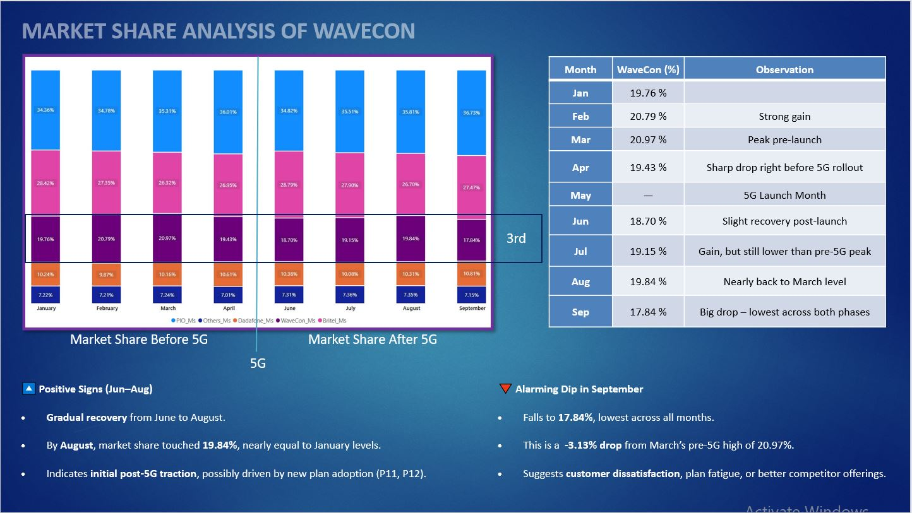
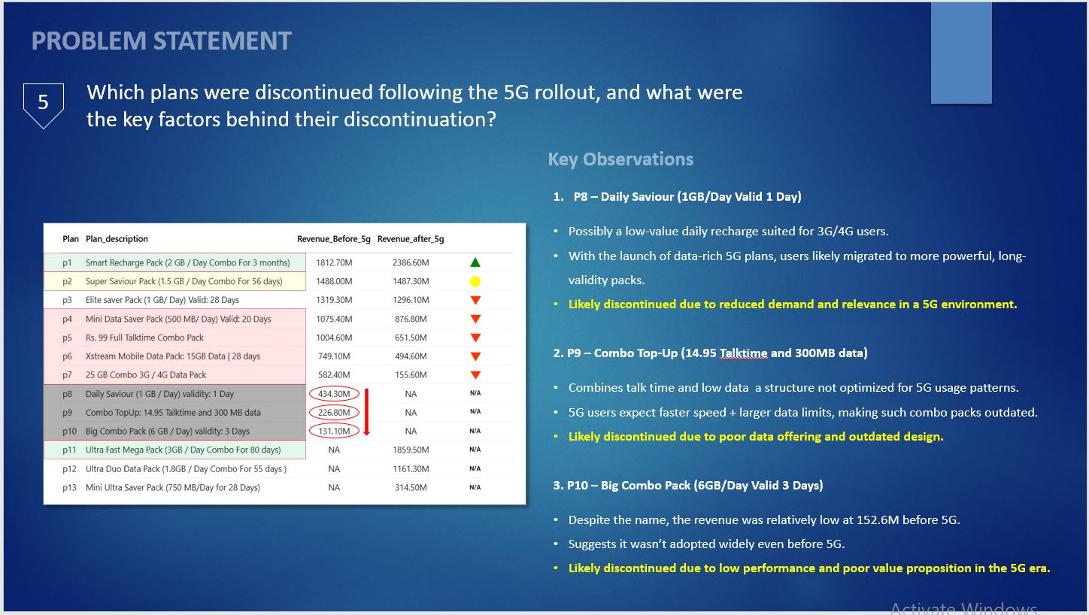
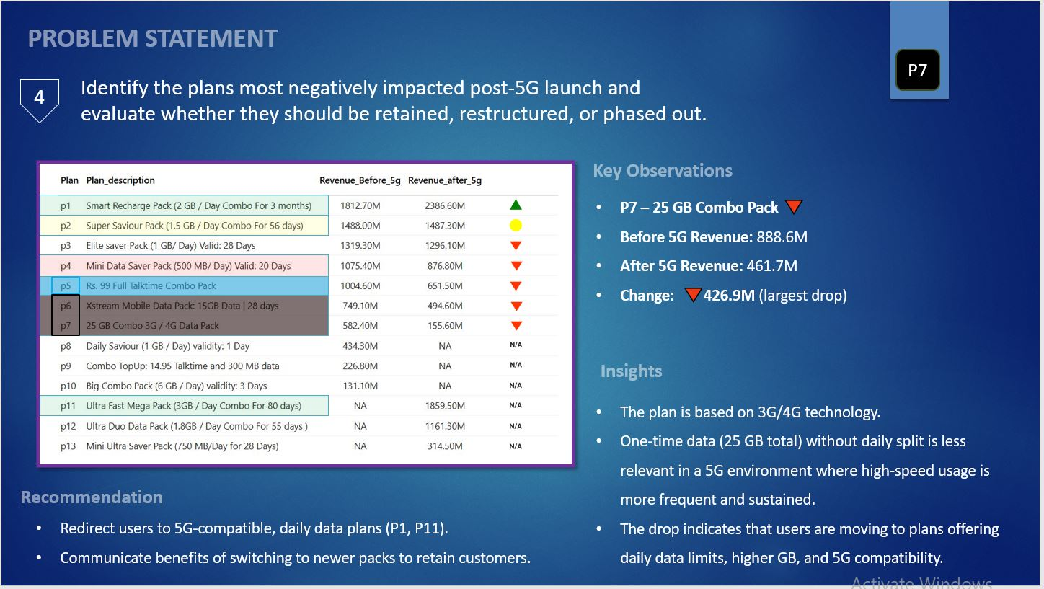
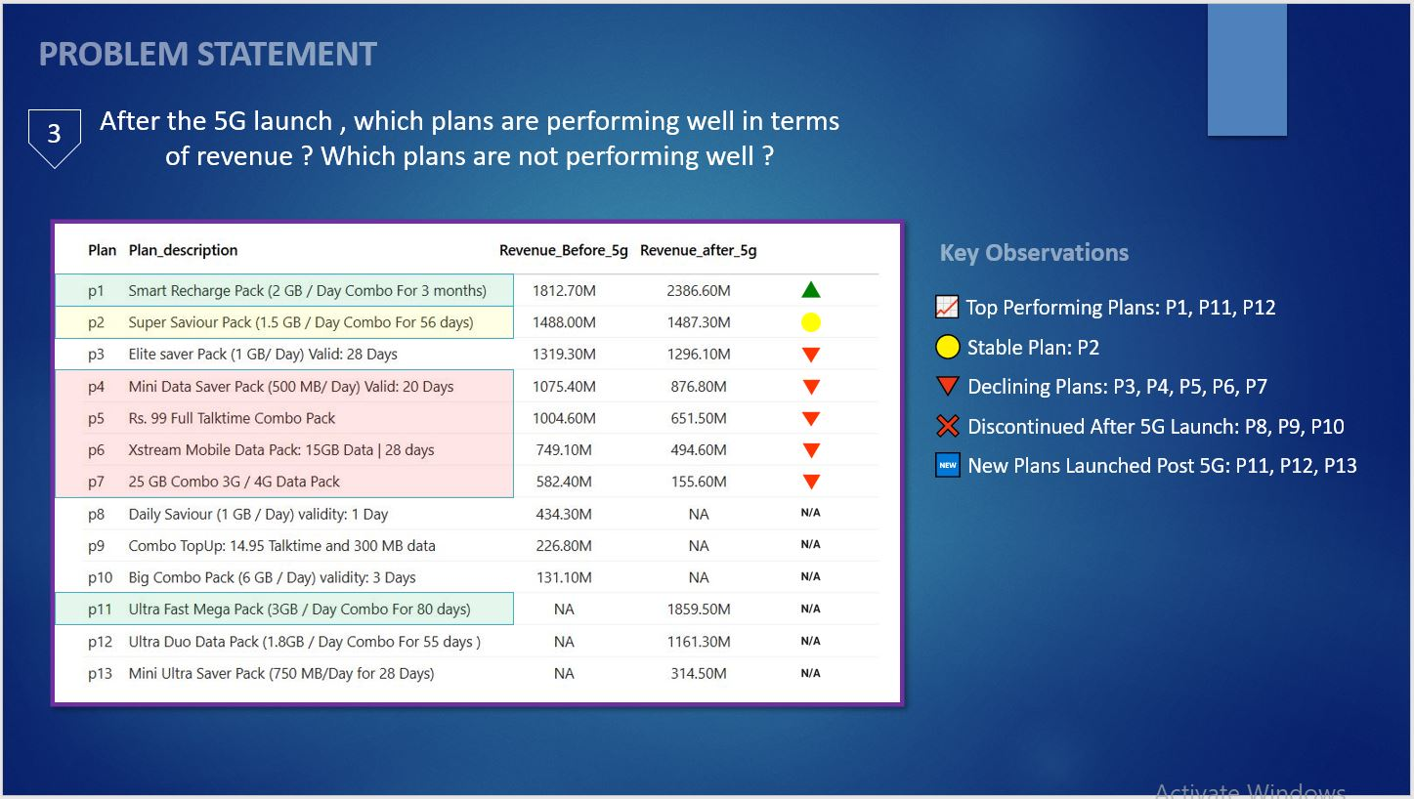
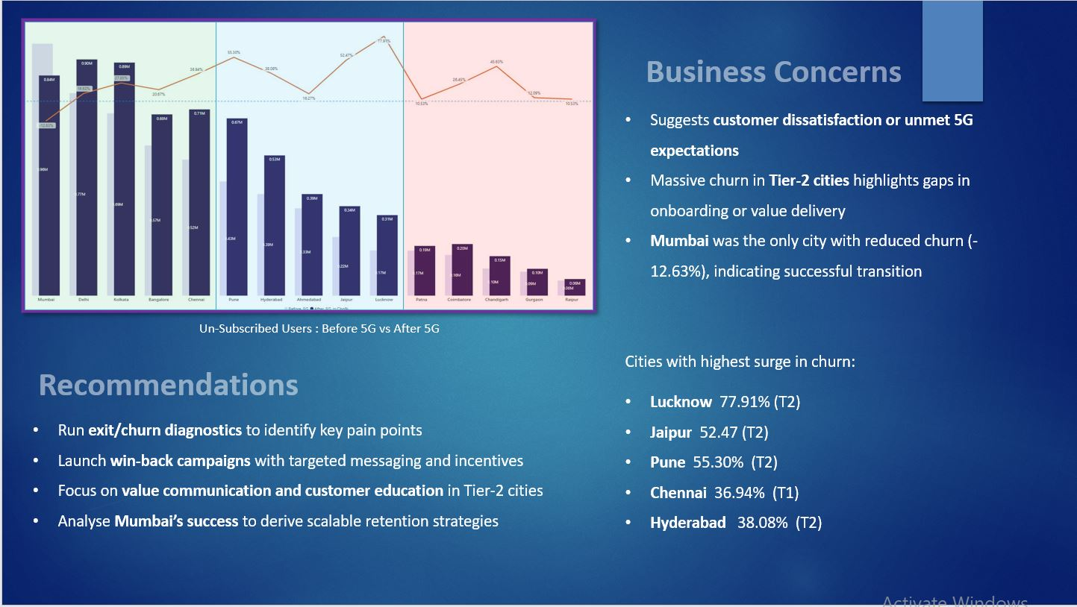
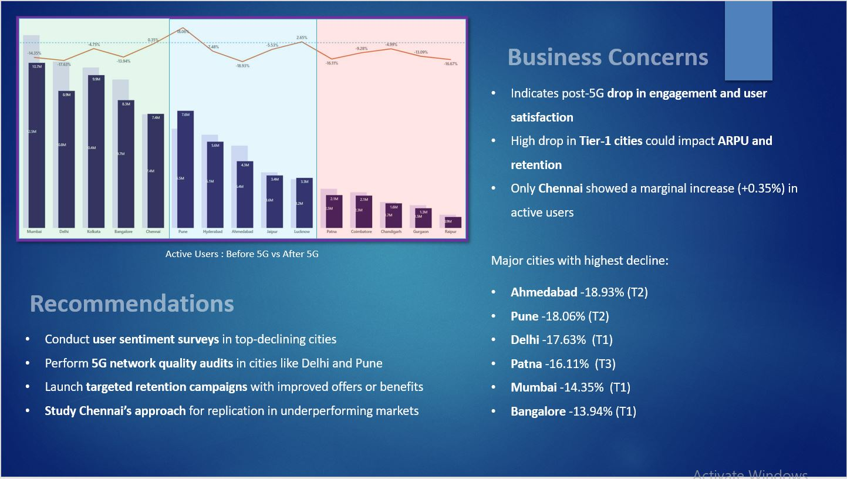
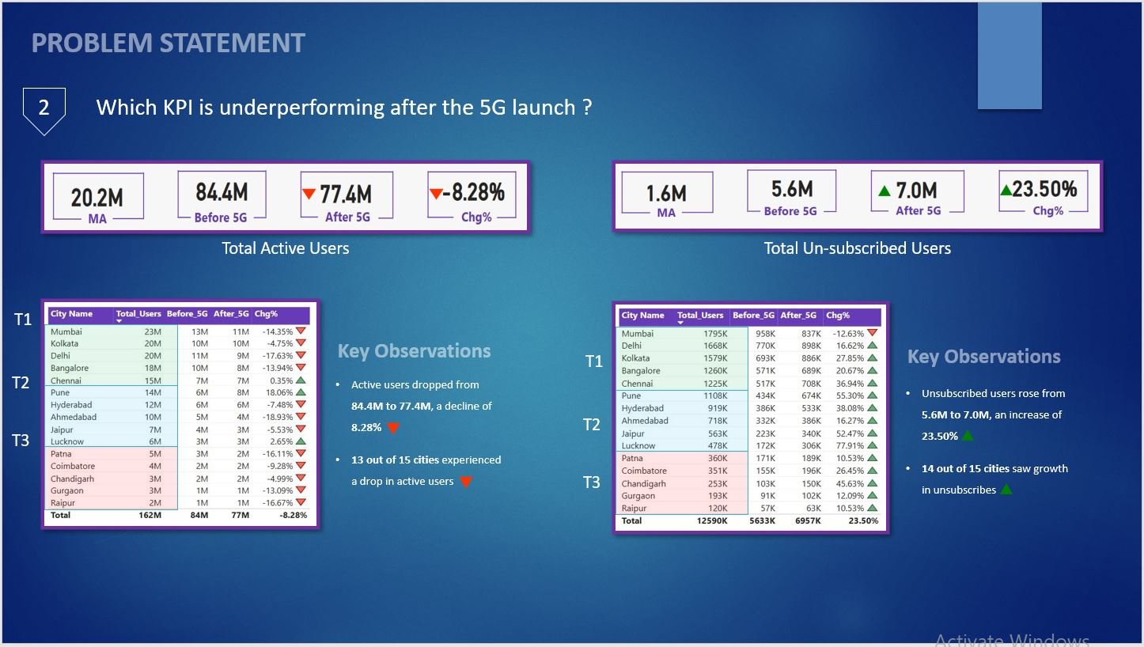
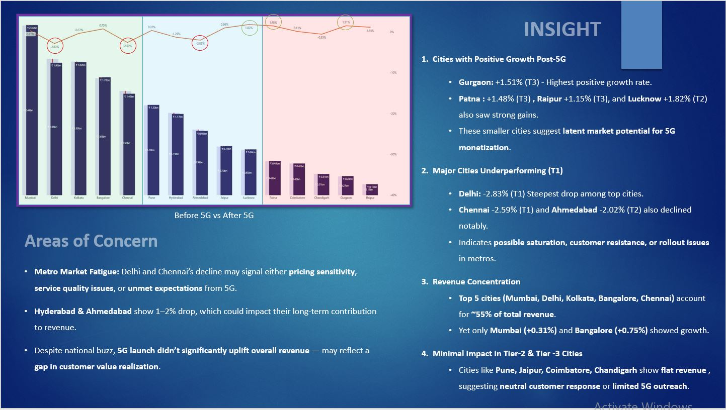
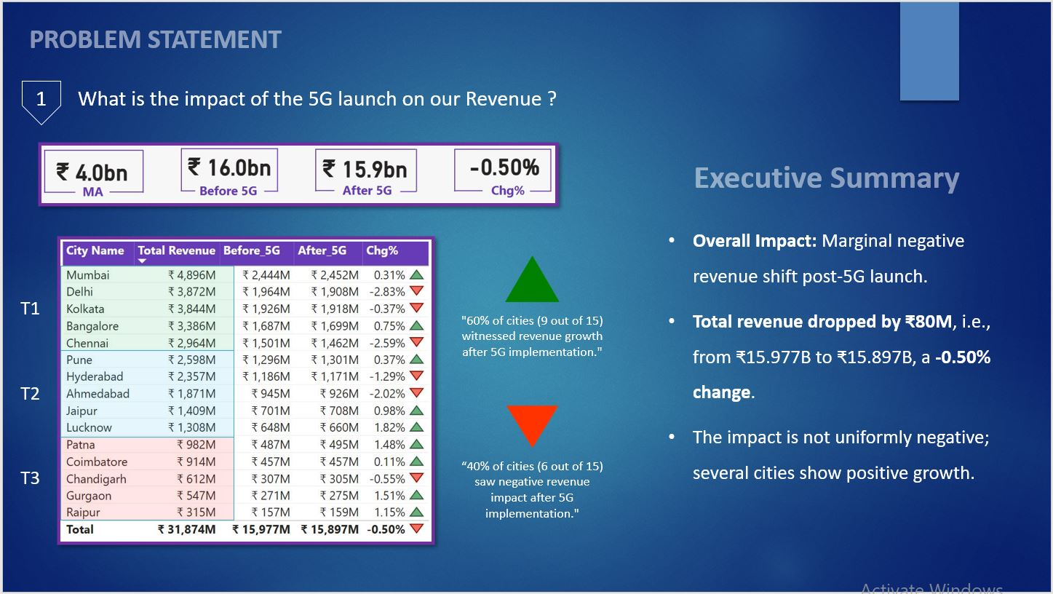
5G Unplugged: Uncovering Insights from Wavecon Telecom’s Data
A data-driven deep dive into performance post-5G rollout
Powered by Power BI & SQL

Slide 19
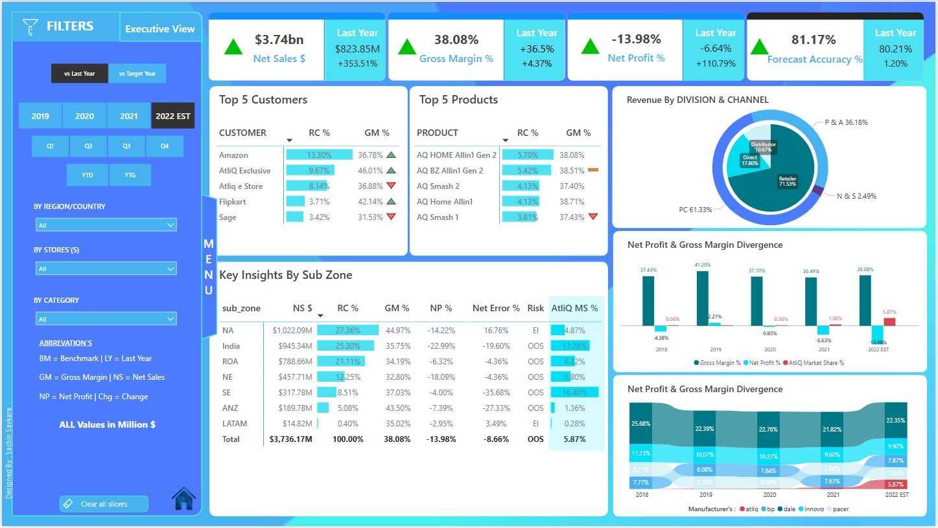
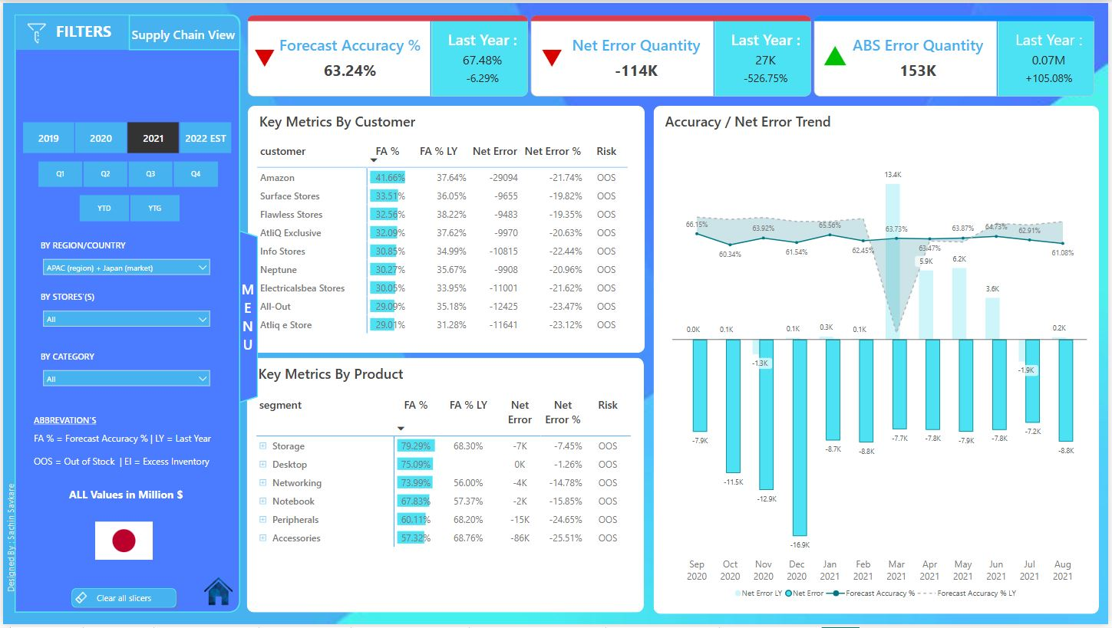
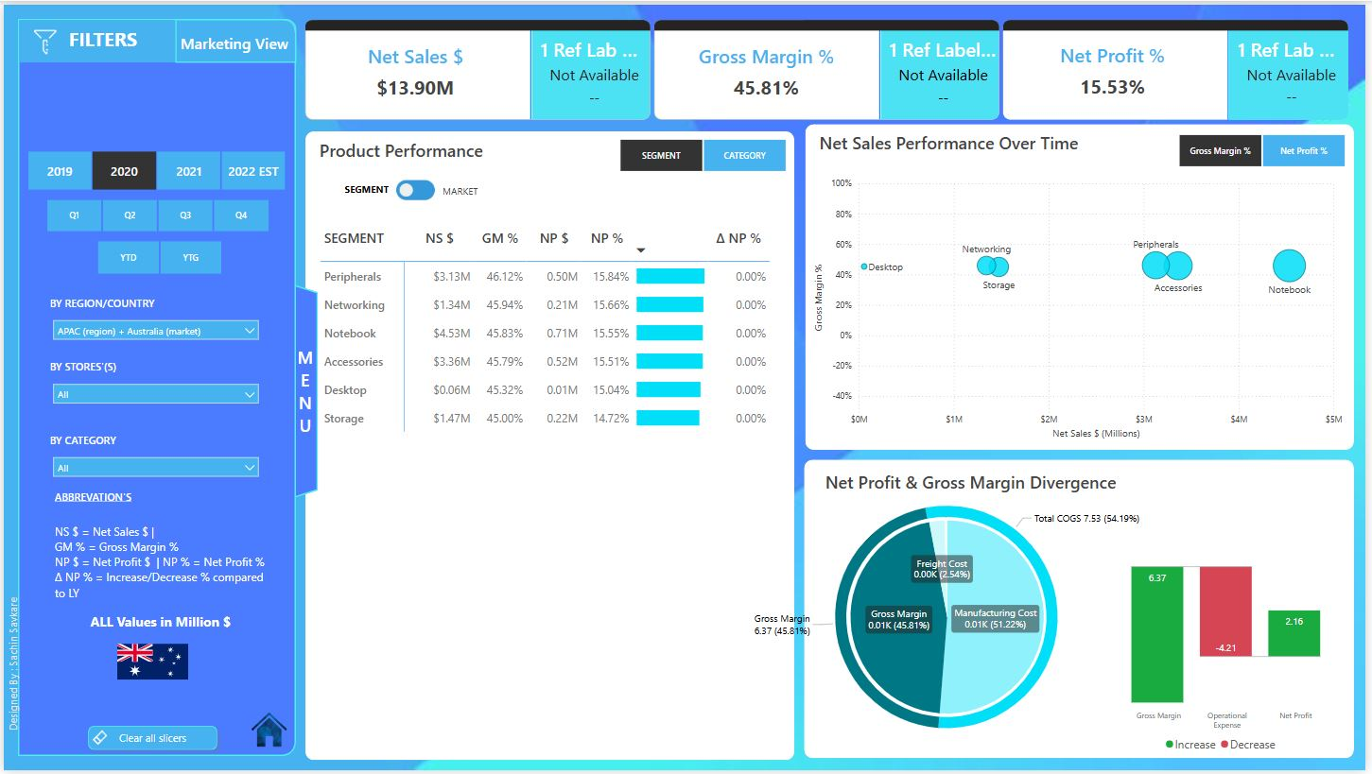
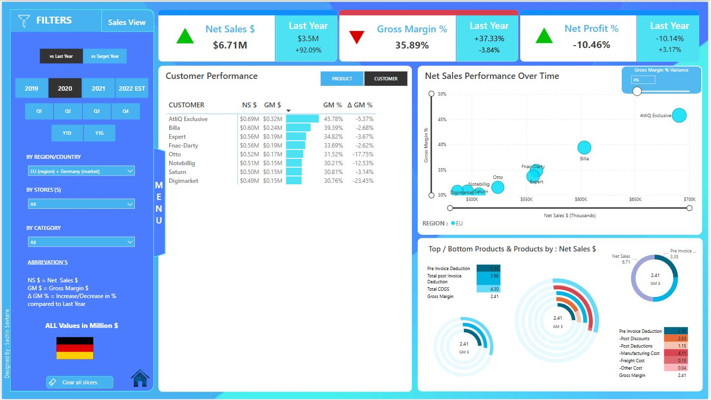
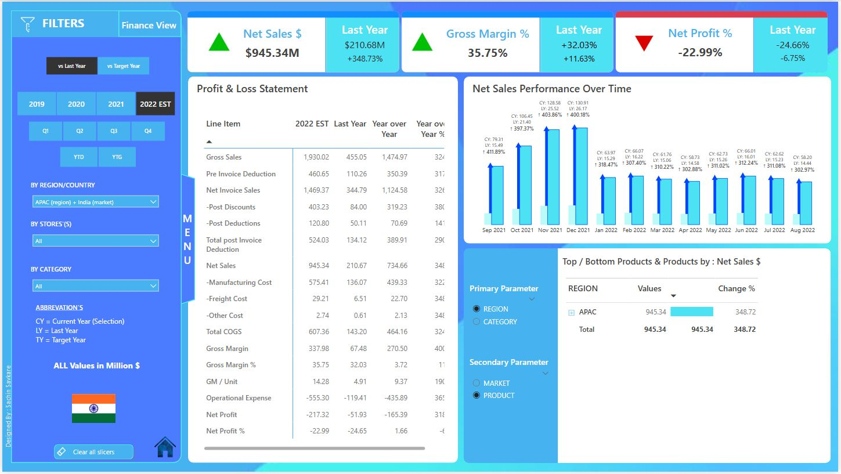
Business Insights 360 | Power BI Dashboard Driving Smarter Decisions Across Finance, Sales, Marketing, Supply Chain & Executive Views

Slide 20
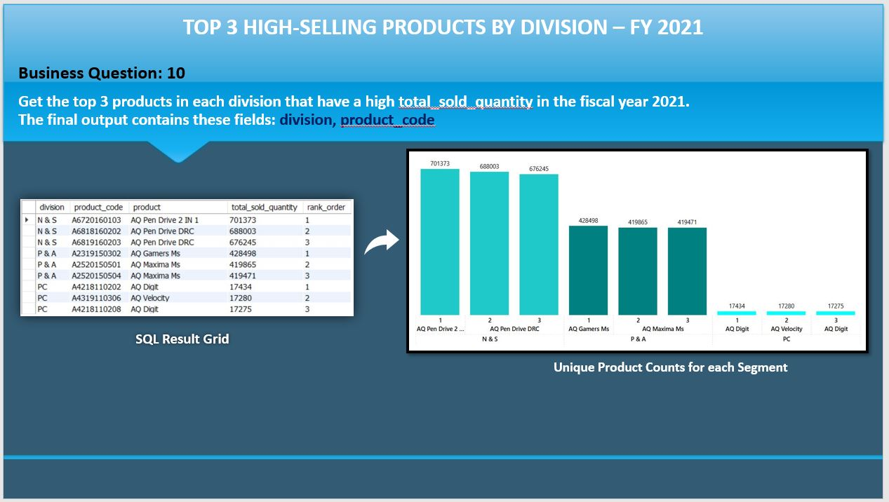
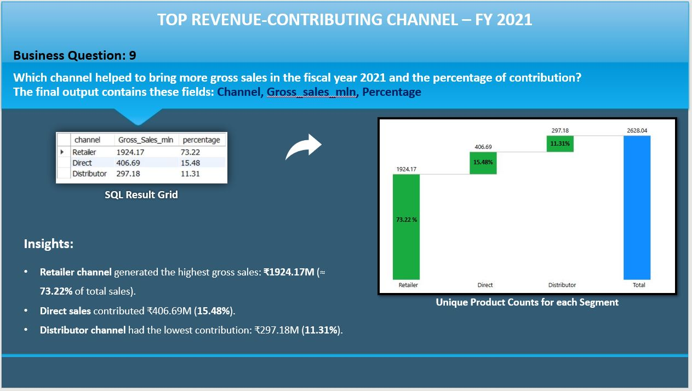
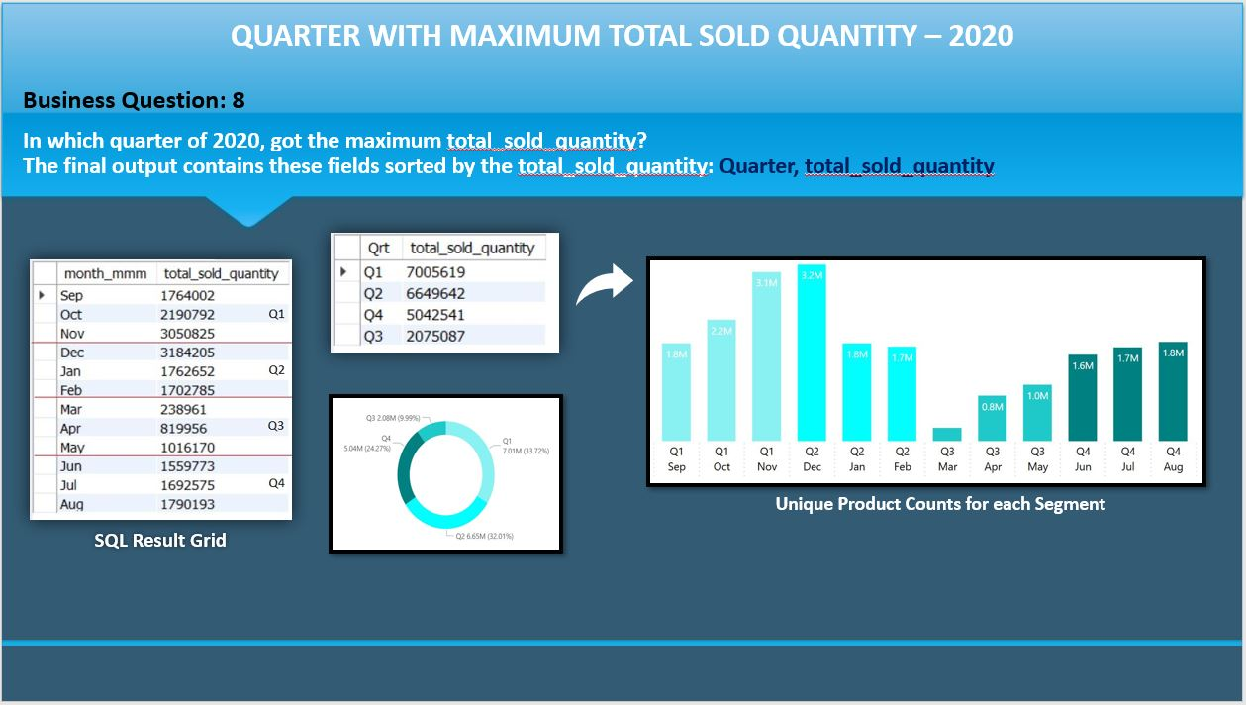
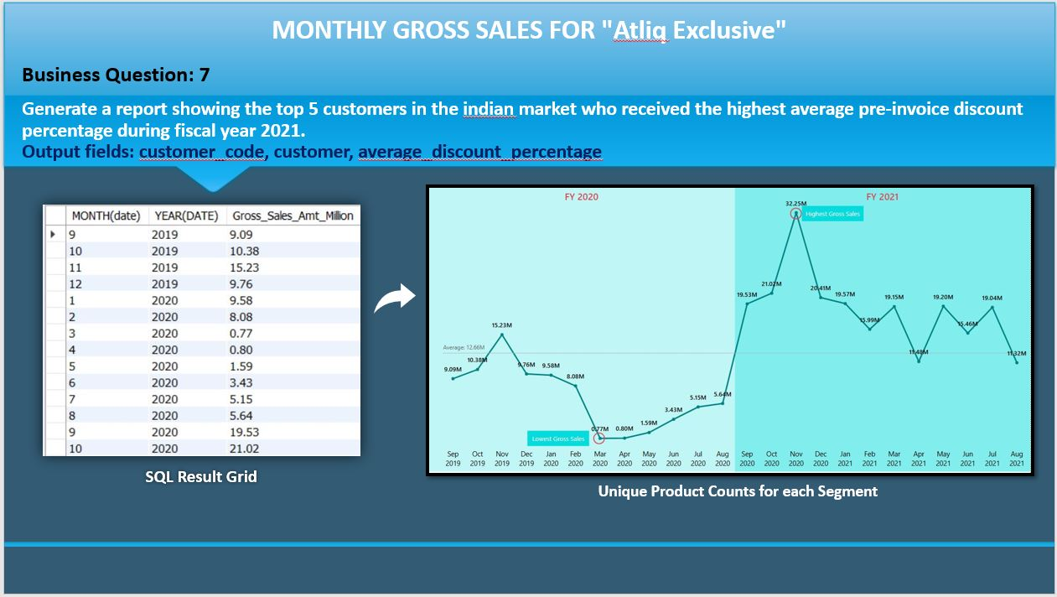
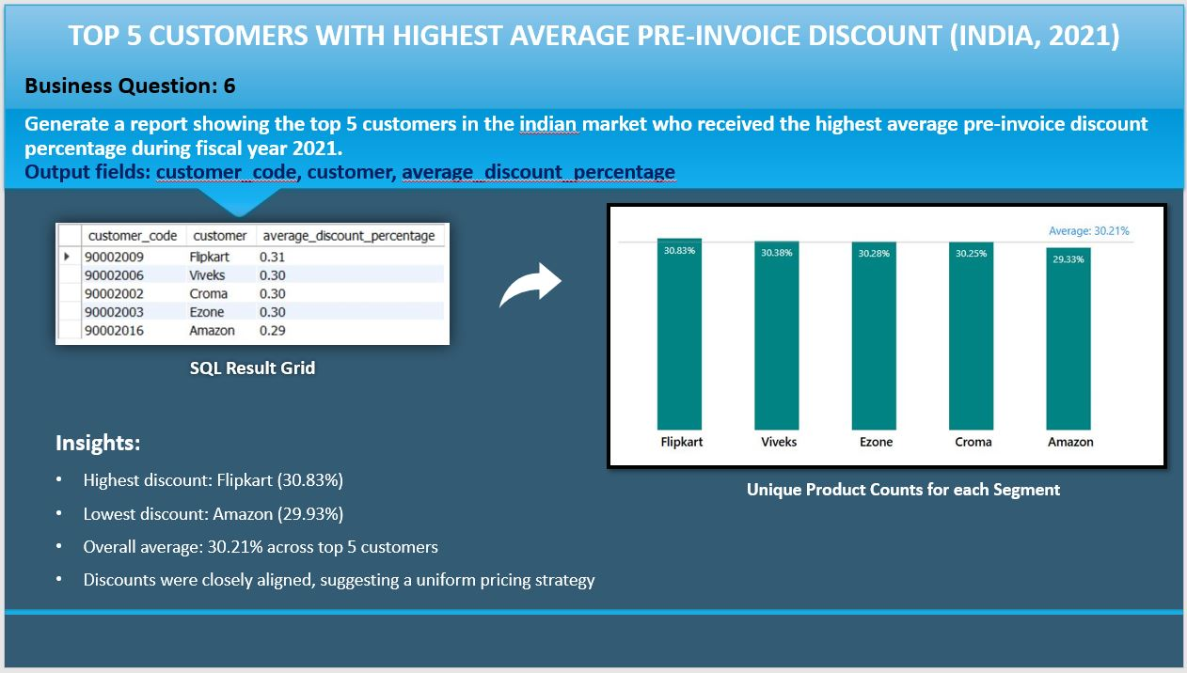
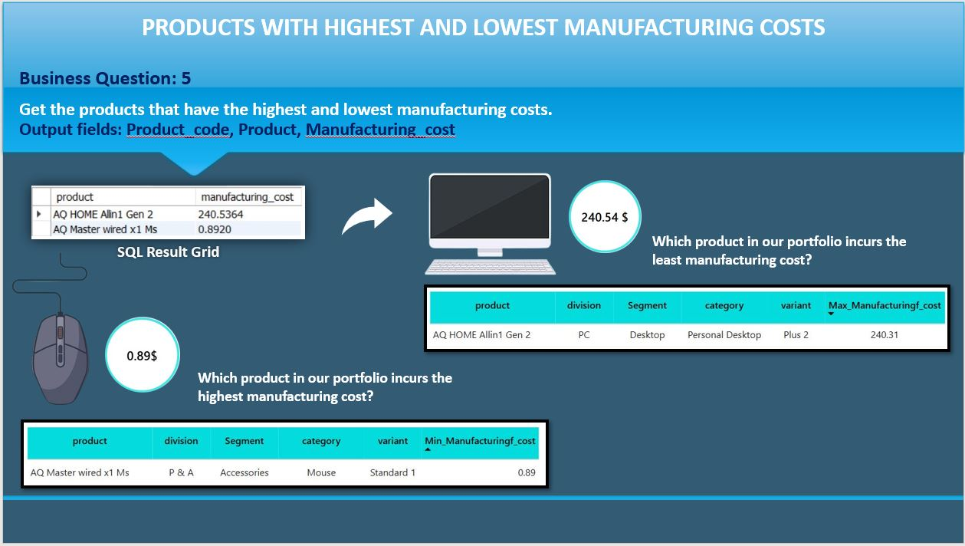
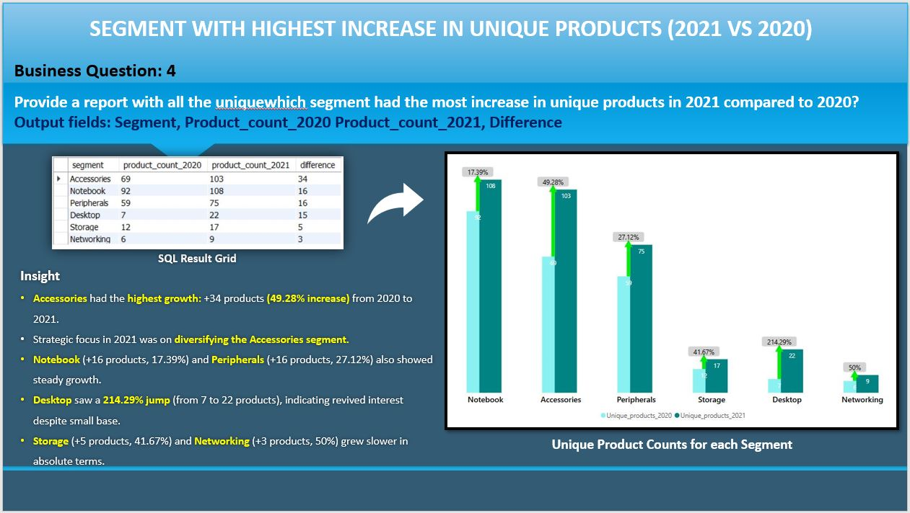
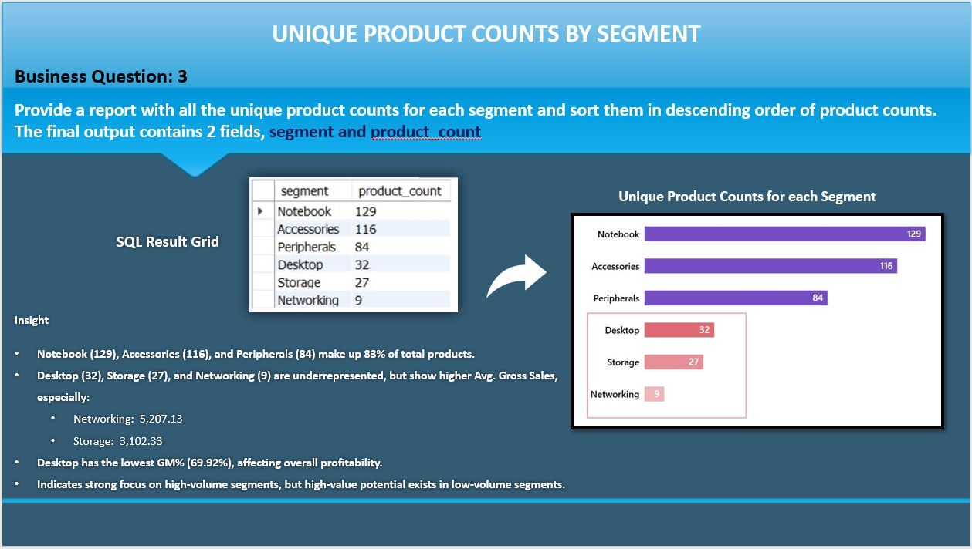
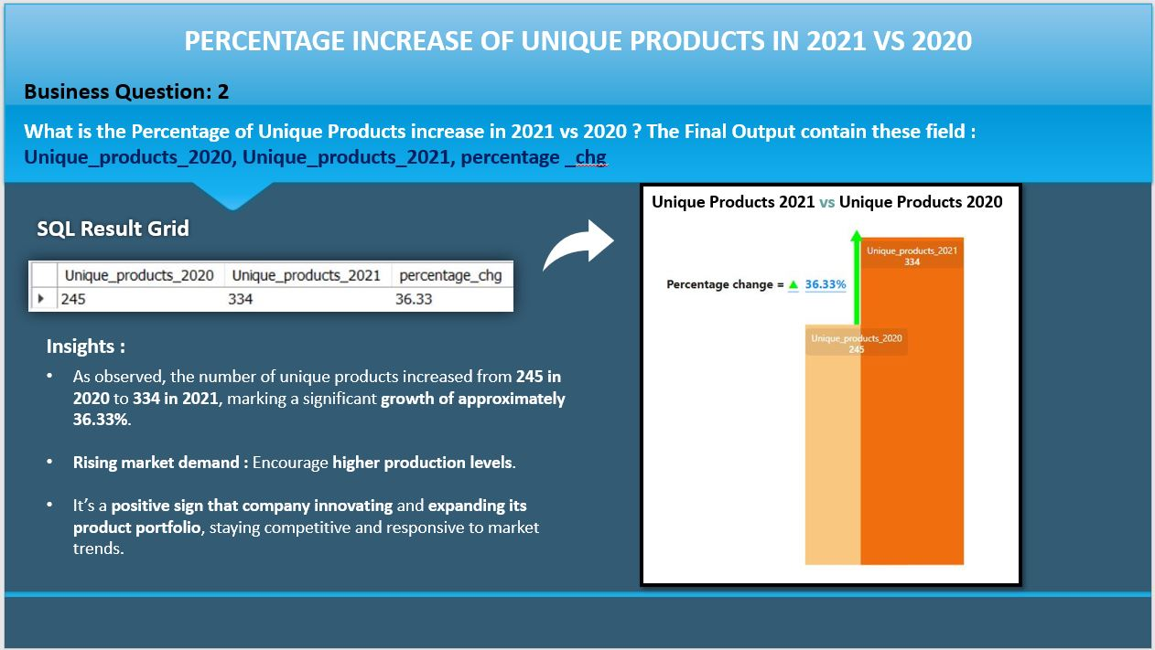
Analysis of 10 Ad-Hoc Requests: SQL Query Results, Strategic Insights, and Data Visualizations for AtliQ Hardware (Consumers Goods)

Slide 21
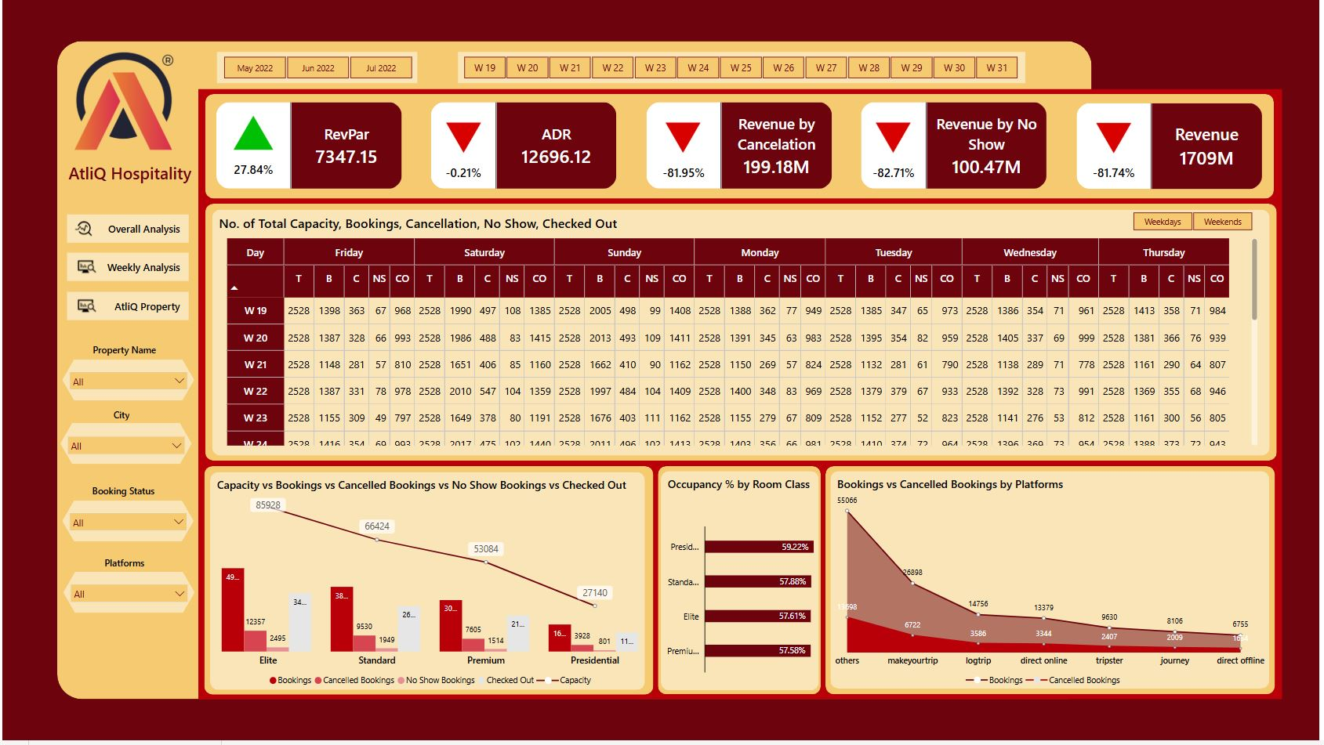
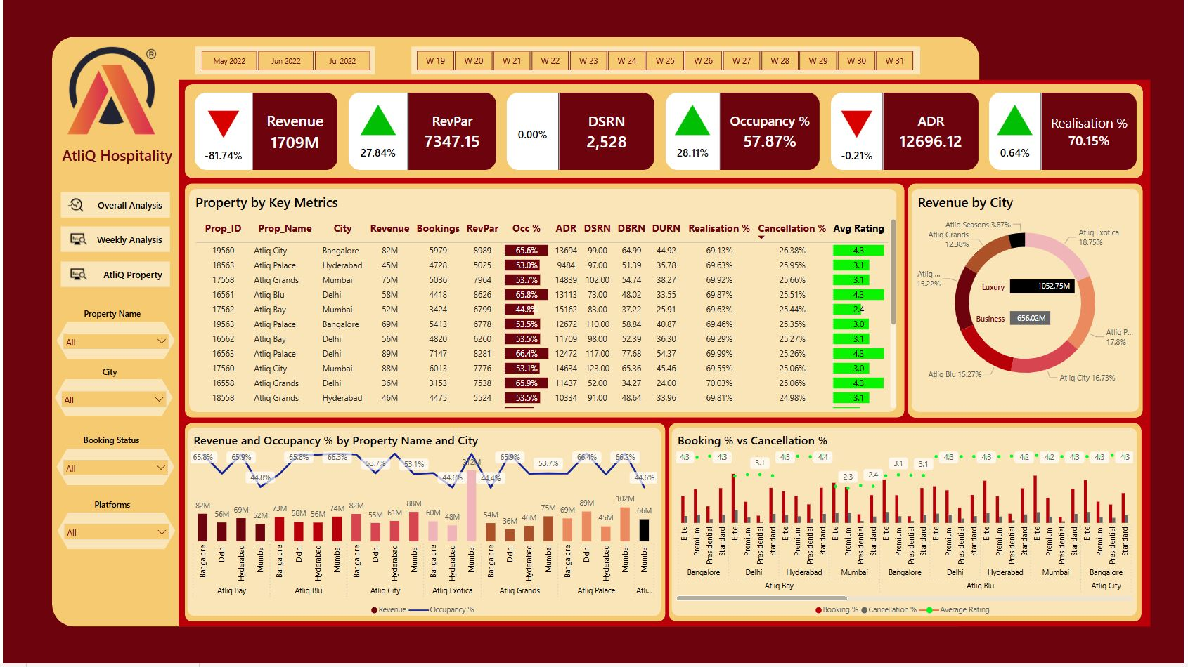
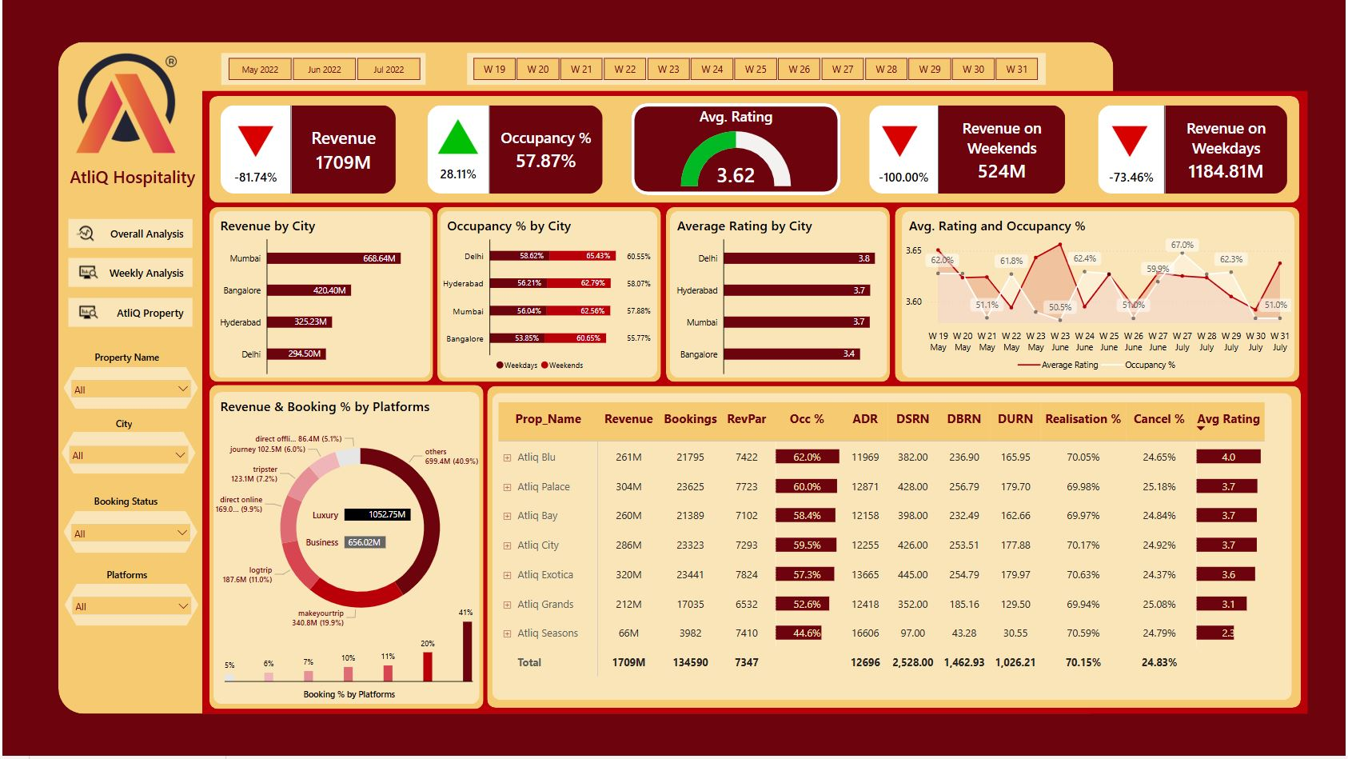
Unlocking Hospitality Growth: Power BI Insights Driving Revenue & Strategy for AtliQ Grands

Slide 22
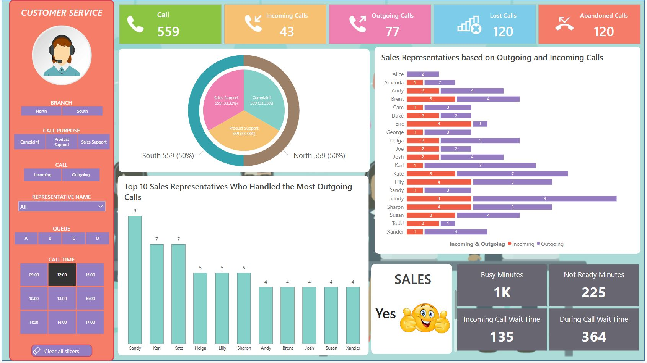
Customer Experience Analytics | Power BI Dashboard for Operational Insights

Slide 23
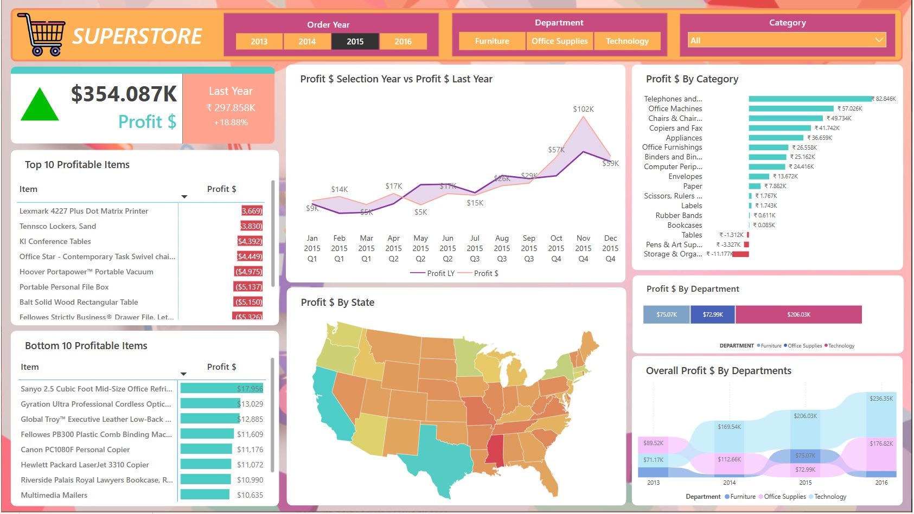
Consumer Goods | Superstore Analysis: Turning Data into Decisions with Power BI

Slide 24
Consumer Goods | Superstore Analysis: Turning Data into Decisions with Power BI

Slide 25
THANK YOU

